Slide 1
describing an orbit in 3D space
Syed Misbah

Slide 2
setting the stage
To describe anything in 3D space, we need to establish a frame of reference.
The primary co-ordinate systems used when describing orbits around the Earth are centered at the center of the Earth
Amongst these, the important ones we will be dealing with are the ECI and the ECEF systems.

Slide 3
THe Earth-centered Inertial system
xy plane coincides with the Equatorial plane
z axis passes through the North Pole
x axis points at the Sun at Vernal Equinox (March 21)
The axes are inertial - they do not move as the Earth rotates.

Slide 4
THe Earth-centered, Earth Fixed system
xy plane still coincides with the Equatorial plane
z axis still passes through the North Pole
x axis is the intersection between the Prime Meridian plane and the Equatorial plane
As a result of the manner the x-axis is defined, the co-ordinate system rotates about the z-axis, with the Earth

Slide 5
KEPLer’s ORBITAL ELEMENTS
Because ideally orbits don’t rotate with the Earth, it is most convenient to use the ECI system to describe it.
The main premise behind which the following orbital descriptions are going to be made are Kepler’s laws
The one most significant in this case is the first one: “The orbit of every planet is an ellipse with the Sun at one of the two foci”
This concept can be further extended to satellites and the Earth.
Amongst the many ways to define an ellipse in 3D, Kepler’s six orbital elements are the simplest and most widely used.

Slide 6
the shape and size of the ellipse
The main elements of an ellipse are listed to the left
The only independent elements out of the 4 listed, are a and e. b is actually =a√(1-e^2)
Different values of a and e can describe any ellipse on a 2D plane (centered at 0,0)
Because they comprehensively describe ellipses of all shapes and sizes, they are the first two Orbital Elements - length of semi-major axis and eccentricity
a - length of semi-major axis
b - length of semi-minor axis
f - length of focus
e - eccentricity = f/a (0<e<1)
-

Slide 7
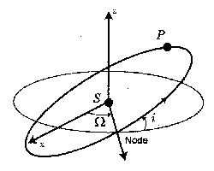
The ORIENTATION OF THE ORBITAL PLANe
The orientation of any plane, in polar co-ordinates can be defined by two angles.
These angles are similar to the latitude and longitude used to describe a point on the Earth’s surface
The latitude is equivalent to the inclination, i, the angle between the the orbital plane and the equatorial plane
The longitude is equivalent to the Right Ascension of the Ascending Node, Ω, the angle between the ECI x-axis and the line connecting the center to the Ascending node.
The Ascending Node is the point where the satellite passes from below the equatorial plane to above it.
Ω lies on the equatorial plane.
Ω

Slide 8
The orientation of the ellipse on the orbital plane
The point on the orbit closest to the center is called the Periapsis. When the center is the Earth, it is called Perigee.
We know the shape and size of the ellipse, and the plane it lies on, but the orientation of the ellipse on the orbital plane hasn’t been decided
To establish this, we have the Argument of Perigee, ω, the angle between the line connecting the Earth and the Ascending node to the point of Perigee.
ω lies on the orbital plane.

Slide 9
The location of the satellite on its orbit
We have completely described an ellipse in 3D space
However, there is one additional quantity that relates the position of the satellite on the orbit in time, thus transforming a mere ellipse to a real orbit.
This quantity, Initial Mean Anomaly, M0, is a virtual angle representing the amount of the orbit that has been completed from the perigee at the moment the satellite begin its orbit.
For example, if the point at which the satellite starts its revolution is the perigee, the M0 would be 0. If it was at the apogee (the furthest point from the Earth), the M0 would be π.
If the time interval between release and the present is known, with the Initial Mean Anomaly, it’s position can be determined.

Slide 10
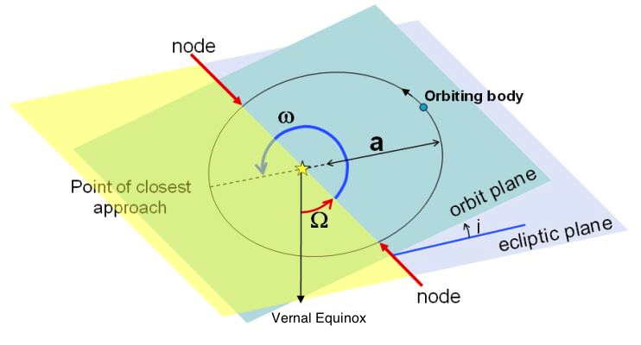
ORBITAL ELEMENTS: CONCLUSION
1. Length of Semi-major Axis (a)
2. Eccentricity (e)
3. Inclination (i)
4. Right Ascension of Ascending Node (Ω)
5. Argument of Perigee (ω)
6. Initial Mean Anomaly (M0)

Slide 11
A Note on anomalies
There are two more kinds of anomalies: Eccentric Anomaly (E) and True Anomaly (υ).
Eccentric Anomaly is the angle between the line connecting the center of the ellipse and the periapsis and the center and point of satellite on the ellipse’s auxiliary circle.
The True Anomaly is the angle between the line connecting the line connecting the Earth and the periapsis and the Earth and the satellite.
With the Earth at the the origin of a 2D plane, the ellipse can be described by the polar equation r=(a(1-e^2))/(1+ecos(ν)).
If the orbit was circular, M=E= ν.

Slide 12
CONVERSION OF STATE VECTORS INTO ORBITAL ELEMENTS
State Vectors are the two vectors representing the Position of the Satellite at release in the ECI system, and the Velocity of the same.
One of the functions of the space block is to convert these state vectors to orbital elements.
The orbit Violet is expected to follow a Low Earth Orbit (LEO), an orbit with altitudes between 200 and 2000 km. These orbits have low eccentricities, below 0.15.

